Slide 1
Presentation on
Comparative study of SVM, KNN and Decision Tree for Diabetic Retinopathy Detection
Presented By
Sohanoor Rahman
ID: 23273009
CSE713

Slide 2
Motivation/Purpose/Aims/Hypothesis
Early detection of diabetic retinopathy can prevent harm to eyes.
ML techniques have shown promising results.
This paper compared three models performance.
Aims to identify the most accurate model.
Explored the impact of different hyperparameters.

Slide 3
Contribution
Authors have made significant contribution in the field.
Conducted a comparative study of three ML models.
Used CNN for feature extraction.
Provided insights of effectiveness of these ML models.

Slide 4
Methodology
Study used ML and CNN approach for detection eye diseases.
CNN was employed for feature extraction.
Dataset used for testing and training consisted of 3662 images.
224x224 pixels of filtered size image was used.
Dataset divided into 80:20.

Slide 5
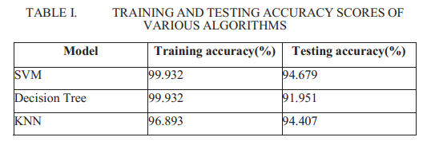
Results and Conclusion

Slide 6
Limitation
Limitation I
The study used a dataset of 3,662 retina scan images, which may not fully represent the diversity and variability of real-world diabetic retinopathy cases. This limited dataset size could potentially affect the generalizability of the ML models and their performance in real-world scenarios.
Limitation II
The use of an external dataset for validation was not mentioned in the paper. To evaluate the effectiveness and generalizability of the ML models using unobserved data from various sources, external validation is crucial. The lack of external validation makes it more difficult to assess the models' robustness and dependability outside the study's particular dataset.

Slide 7
Synthesis
Larger amount of data.
Improving model accuracies.

Slide 8
Thank you!

